Slide 1
What is Power BI
What is Power BI

Slide 2
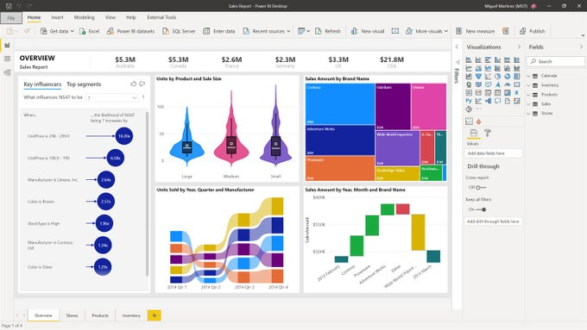
Not a simple Software

Slide 3
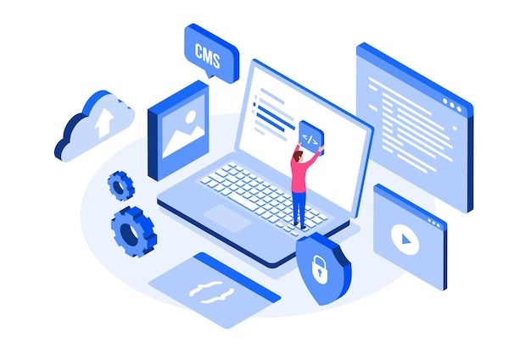
An ecosystem

Slide 4
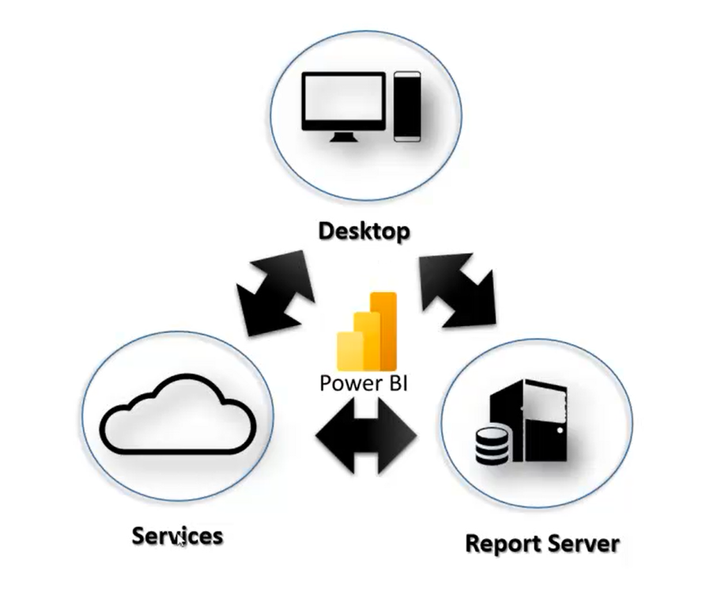

Slide 5
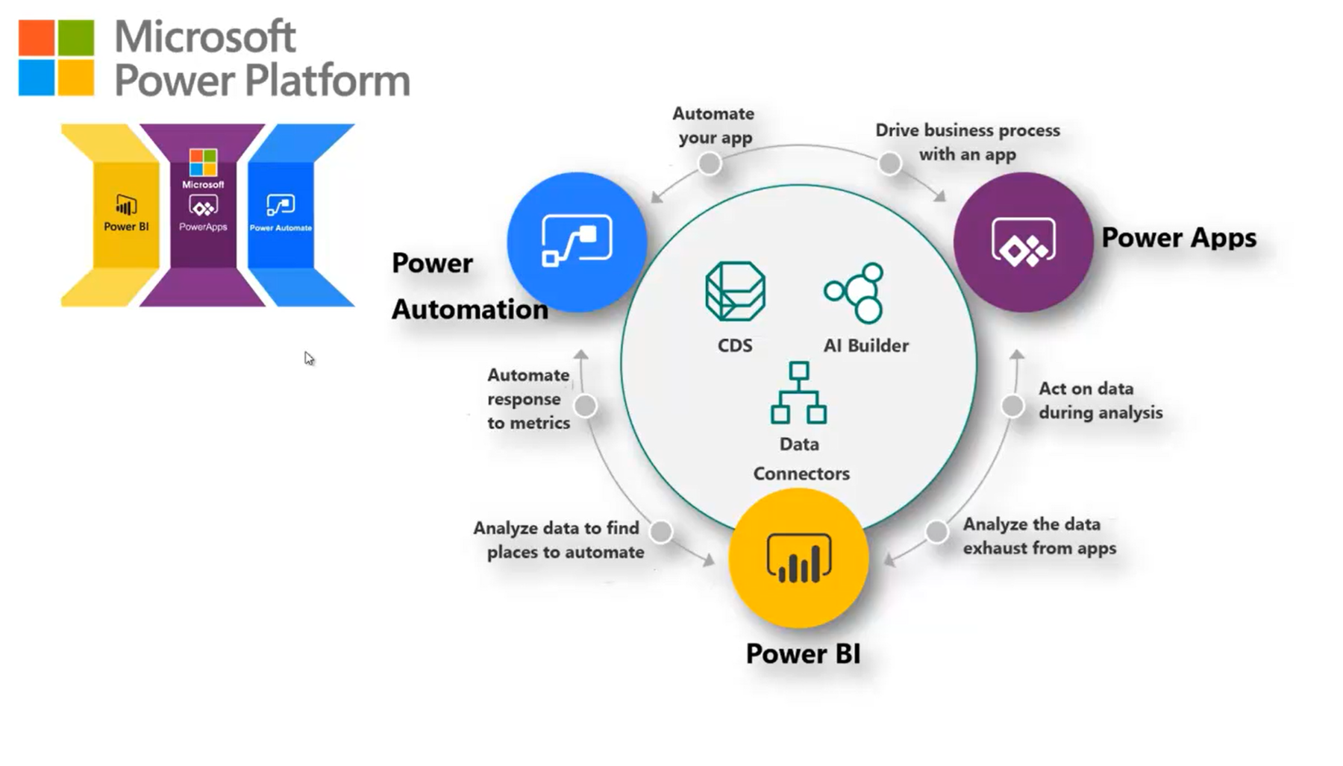

Slide 6
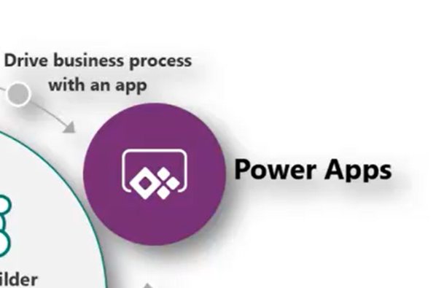
Power Automate:
Automates responses to metrics.
Simplifies business processes with automated workflows.
Power Apps:
Enables the creation of business applications.
Allows actions on data analyzed by Power BI.
Power BI:
Analyzes data to identify automation opportunities.
Helps find actionable insights for business processes.
Data Connectors:
Links apps to external and internal data sources.
CDS (Common Data Service):
Manages data across the platform.
AI Builder:
Adds artificial intelligence capabilities to apps.
Notes:
CDS (Common Data Service):
Centralized Data Management: Acts as a database to store and manage structured data.
Data Integrity: Ensures consistent data relationships, validation, and security.
Power Platform Integration: Seamlessly integrates with Power Apps, Power BI, and Power Automate.
Built-In Intelligence: Supports AI Builder for predictive insights and AI capabilities.
Custom Entities: Allows creation of tailored entities specific to business needs.
Data Connectors:
Integration with External Sources: Connects Power Platform apps to various external data sources (SQL Server, SharePoint, Excel, etc.).
Real-Time Data Access: Enables live connection to cloud or on-premises data.
Pre-Built and Custom Connectors: Offers hundreds of pre-built connectors and supports custom API-based connectors.
Versatility: Works across Power BI, Power Apps, and Power Automate for extracting, transforming, and visualizing data.
Lightweight and Flexible: Focuses on accessing data rather than storing it.

Slide 7
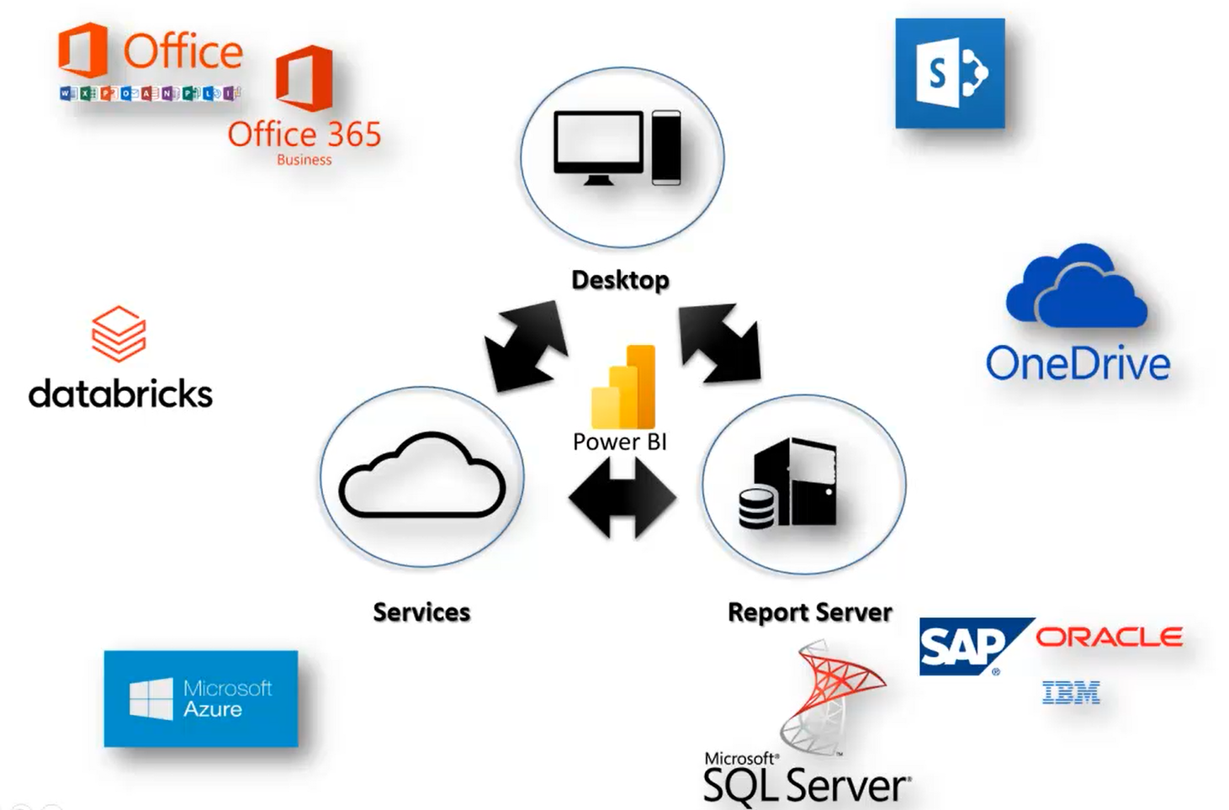

Slide 8
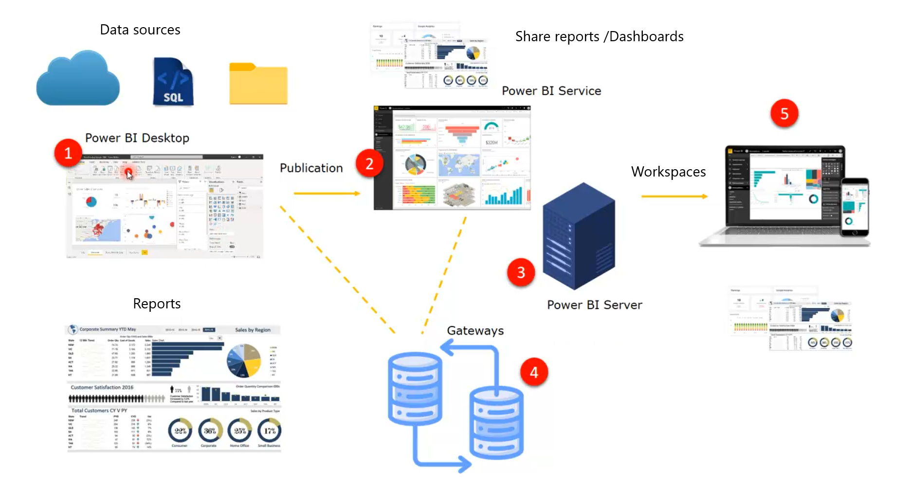

Slide 9
Power BI is easy to learn
Power BI is portable, compatible with laptops, desktops, tablets, and mobile devices.
Power BI offers extensive connectivity to various sources via cloud computing or other platforms. This feature helps data scientists analyze data from multiple data sources.
Generated data can be shared with stakeholders, who can reshape it into new reports.
Reports and dashboards are reliable and secure, ensuring consistent updates.

Slide 10
Thank you
Thank you

